Slide 1


Data-Driven Recruitment System
Optimizing Biased Talent Acquisition Through Data-Driven HR Analytics

Slide 2
Model Evaluation &
Business impact

Slide 3

Model Comparison
XGBoost outperformed Logistic Regression across all metrics.
F1 Score (77.5% → 84.7%). This quite sharp increase proves that the model is now more balanced and consistent in maintaining the quality of predictions between Precision and Recall.
While both models had high ROC-AUC scores, XGBoost was slightly better (88.9% → 91.3%).
Logistic Regression
F1 Score
ROC AUC
77.5%
88.9%
XGBoost
F1 Score
ROC AUC
84.7%
91.3%

Slide 4
Fairness and Bias Analysis
Feature | Subset | count | positives | positive_rate
RecruitmentStrategy | External | 237 | 27 | 0.114
RecruitmentStrategy | Internal | 133 | 92 | 0.692
RecruitmentStrategy | Referral | 80 | 10 | 0.125
EducationLevel | Diploma/Bachelor | 225 | 46 | 0.204
EducationLevel | High School | 98 | 25 | 0.255
EducationLevel | Magister | 92 | 38 | 0.413
EducationLevel | PhD | 35 | 20 | 0.571
ExperienceLevel | Junior | 48 | 8 | 0.167
ExperienceLevel | Medior | 118 | 30 | 0.254
ExperienceLevel | Senior | 284 | 91 | 0.32
Feature | Subset | count | positives | positive_rate
InterviewScore | Low | 154 | 41 | 0.266
InterviewScore | Medium | 153 | 28 | 0.183
InterviewScore | High | 143 | 60 | 0.42
SkillScore | Low | 140 | 25 | 0.179
SkillScore | Medium | 151 | 43 | 0.285
SkillScore | High | 159 | 61 | 0.384
PersonalityScore | Low | 161 | 39 | 0.242
PersonalityScore | Medium | 139 | 30 | 0.216
PersonalityScore | High | 150 | 60 | 0.4
Recruitment Strategy: The model recommends Internal Strategy significantly higher (0.69) than External or Referral Strategy (0.11), indicating a strong preference for internal sources.
Educational Level: The model tends to recommend candidates with higher education, particularly Master's (0.41) and PhD (0.57) graduates, compared to candidates with a high school or bachelor's degree (0.20 - 0.35)
Experience Level: The model prioritizes senior candidates, but the difference in positive rates across experience levels (Junior, Intermediate, Senior) does not show the extreme gaps found in education or recruitment strategy categories.
The model shows a pattern where higher scores increase a candidate's chances of being recommended for recruitment, particularly in the High score category.
The most significant gap is seen in the Interview Score, followed by the Personality Score. Meanwhile, Skill Score shows a more stable pattern across the Medium and High score ranges.

Slide 5
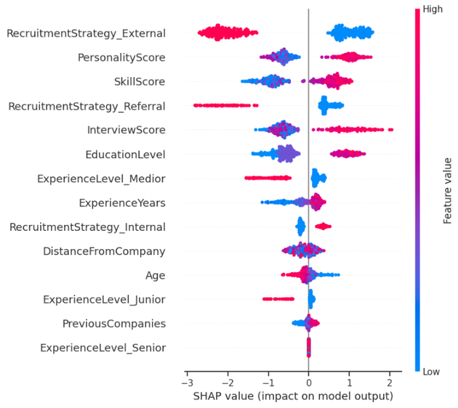
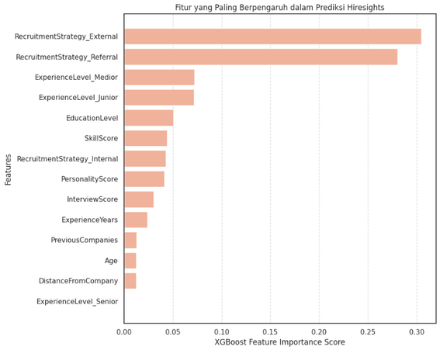
Feature Importance
RecruitmentStrategy_External is the most influential factor, with high feature scores (red) having a very strong negative impact on recruitment decisions.
EducationLevel had a significant positive impact; the higher a candidate's education level and total score, the greater their likelihood of being recommended.
PersonalityScore, InterviewScore, and SkillScore consistently showed a positive impact on the model. Candidates with high evaluation scores on these aspects were more likely to be hired.
The remaining factors, such as DistanceFromCompany, Age, and ExperienceLevel_Senior, had minimal or almost neutral impacts on the prediction model output.
Conclusion: The model was heavily influenced by the recruitment channel (External) and the candidate's academic quality/evaluation score, while demographic factors and specific experience (Senior) were not significant determinants in this model.
The graph shows that RecruitmentStrategy_Referral, RecruitmentStrategy_External, and ExperienceLevel_Medior are the most influential features in this recruitment prediction model.

Slide 6
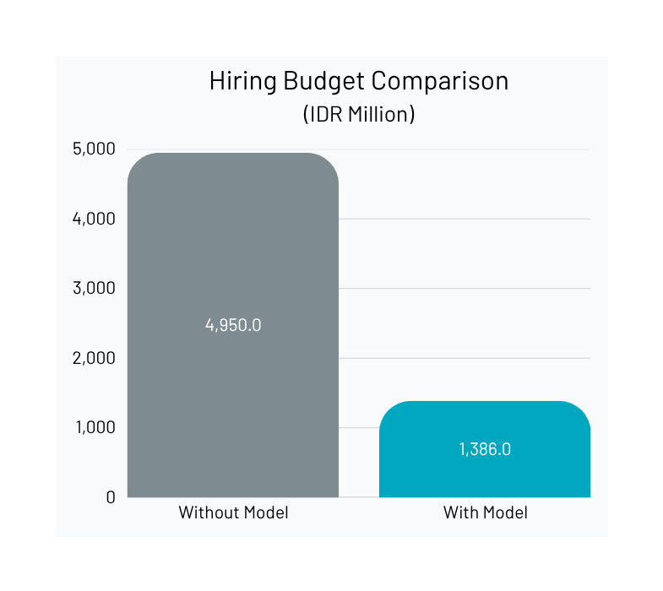
Business Impact
Based on confusion matrix, we have potential hire candidates as:
TP (108) + FP (18) = 126 out of 450 candidates
Cost per Hire: 11.000.000
With Model | Total Hire | Cost per Hire | Total Cost
Yes | 126 | 11.000.000 | 1.386.000.000
No | 450 | 11.000.000 | 4.950.000.000
Cost Saving: Rp 3,564 M
Cost Efficiency: 72 %

Slide 7
Recommendation
Data imbalance & bias: The dataset is limited and shows some bias. This is mitigated using the SMOTE algorithm, which balances data distribution and improves model representativeness.
Conduct a survey per quarter alongside HR Team to bolster data with more information, features to improve model accuracy and maintain model integrity
Retrain algorithm with new data and develop better model that is less biased and more fair.
Optimization of HR Workflow: HR team without the model will continue and screen manually candidates that might be a dud, this will cost the company money while having no benefits.
Dashboard utilization: using the dashboard, HR team can pre-screen the potential candidates without consuming a significant amount of hiring budget to screen off uncertain hires and save the hiring team effort and time.

